Slide 1

Computer Architecture
Tutorial 02 – Logic Gates

Slide 2


Slide 3
Find out 3 real world applications for logic gates

Slide 4
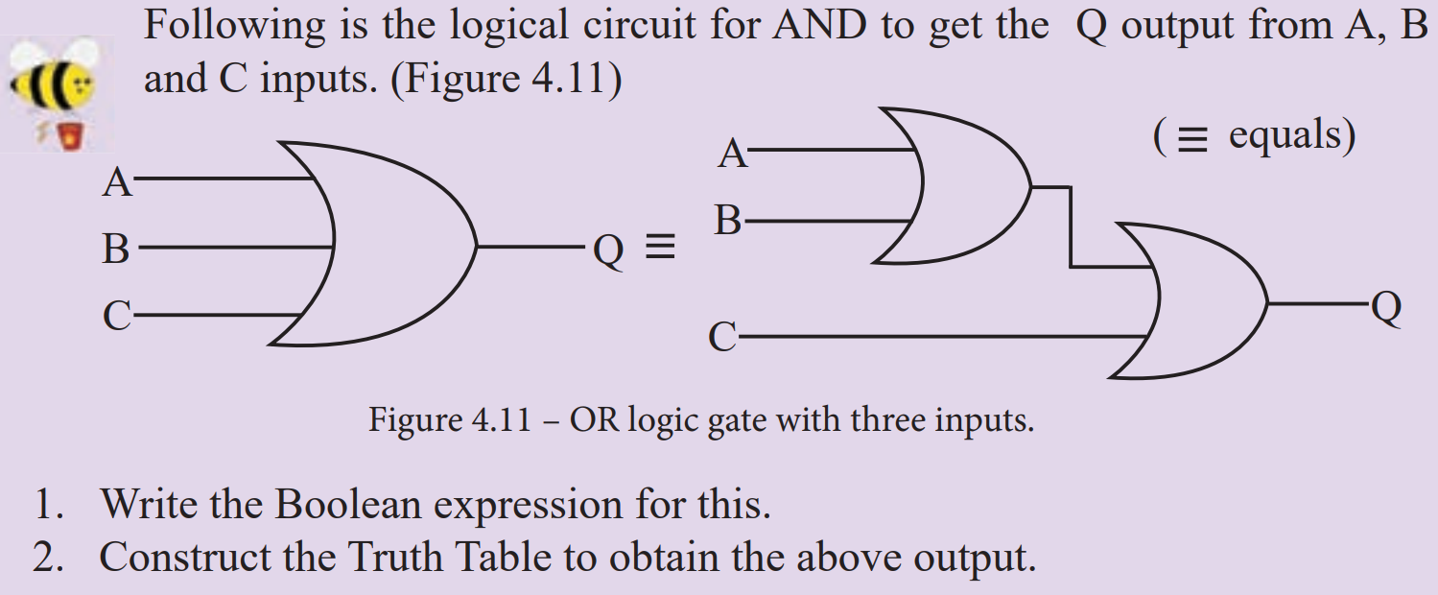

Slide 5
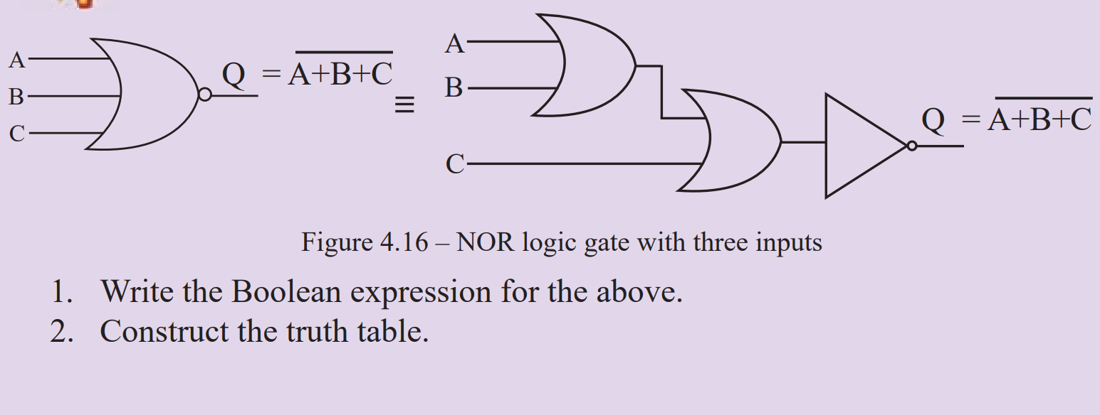

Slide 6
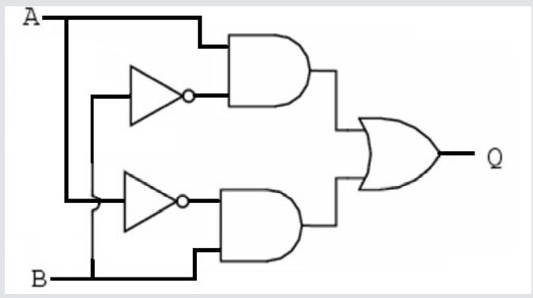
Derive the Boolean Expression

